Slide 1
CAPSTONE
GROUP D

Slide 2
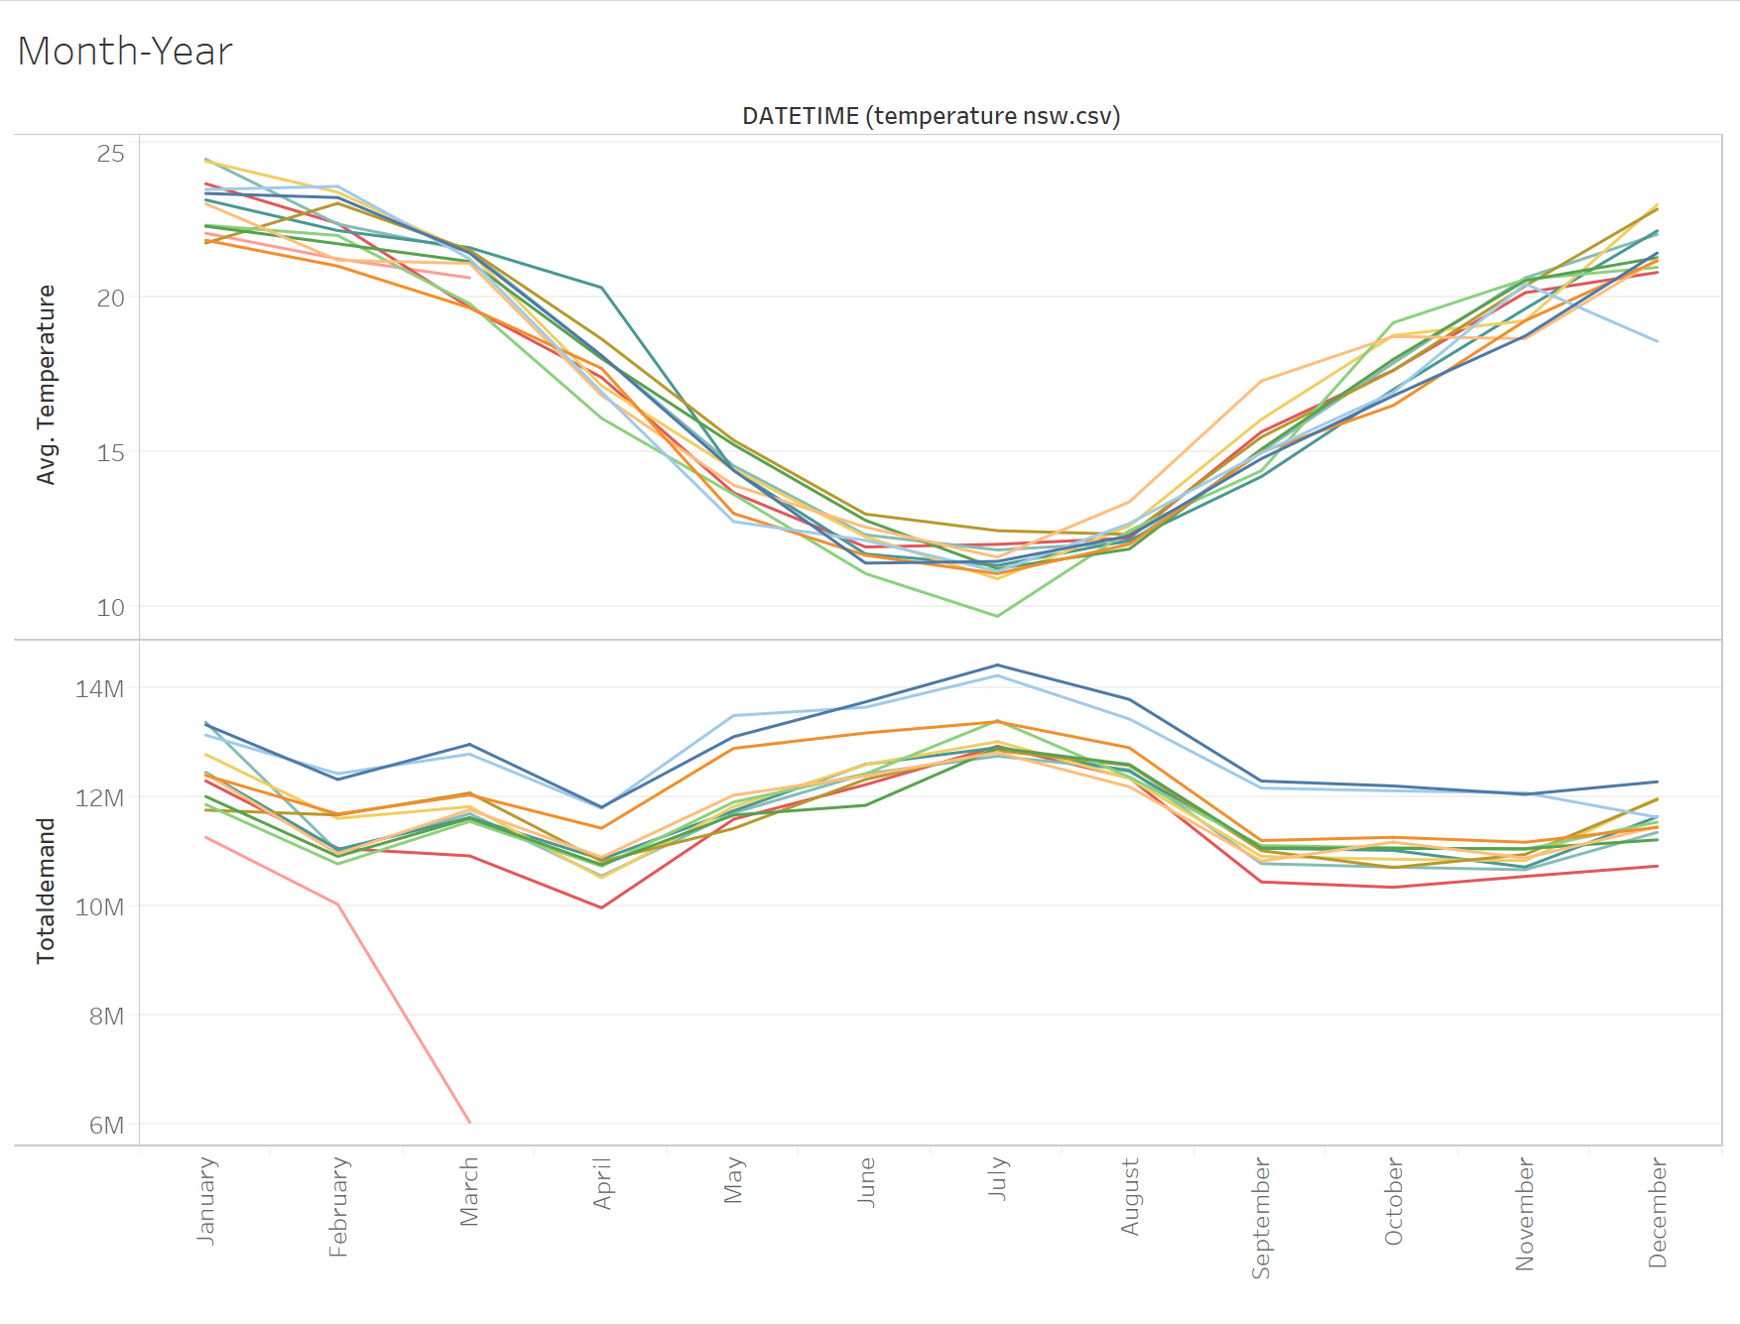
Year to year monthly temperature-demand trend
Given temperature and demand data is from Jan’10 to Mar’21
Monthly avg. temperature varies 2/3 degrees.
Demand is comparatively higher during winter season (Jun-Aug).
Overall demand decreased in the recent years.

Slide 3
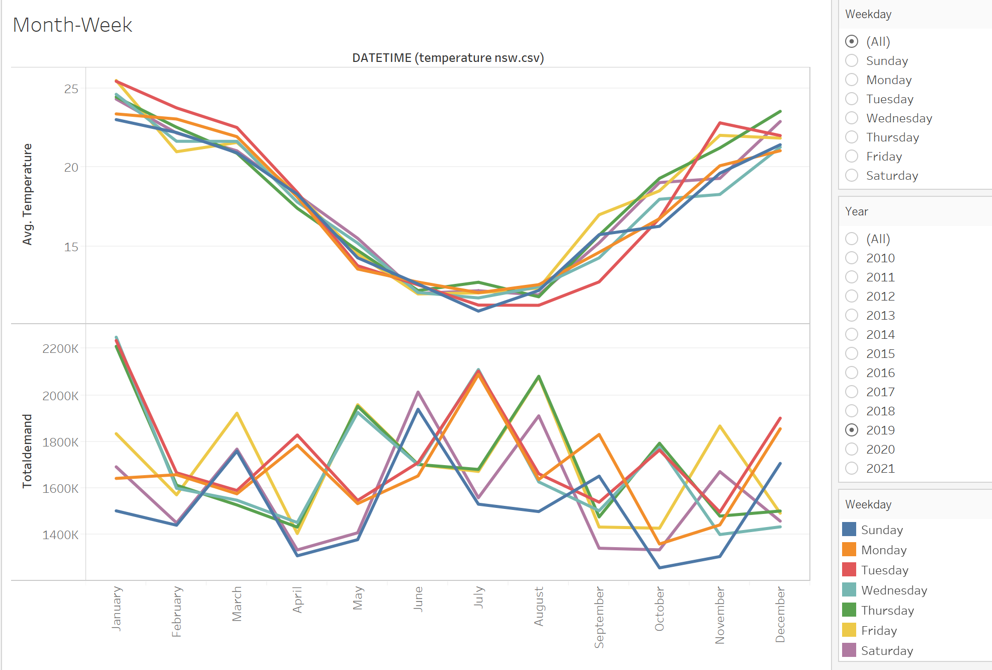
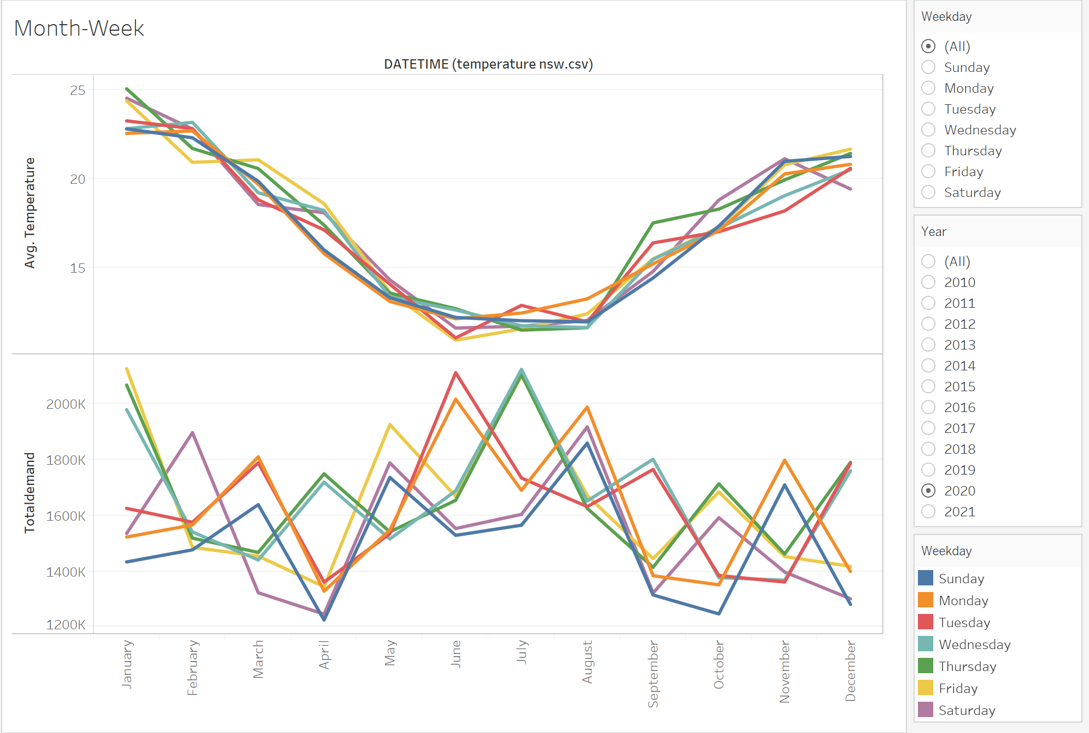
Monthly temperature-demand in diff. weekdays trend
Different months have different demand pattern in different weeks days.
Year to year the pattern is not same.

Slide 4
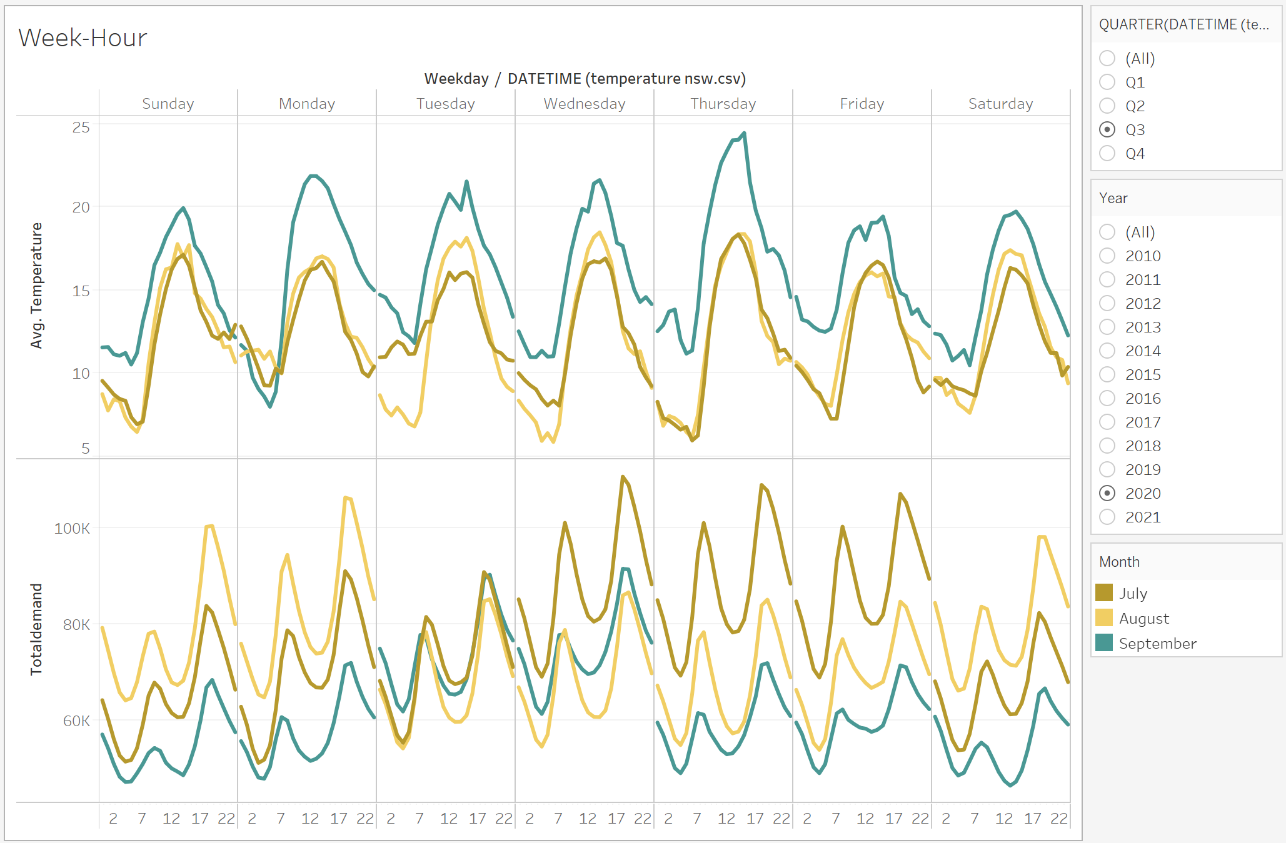
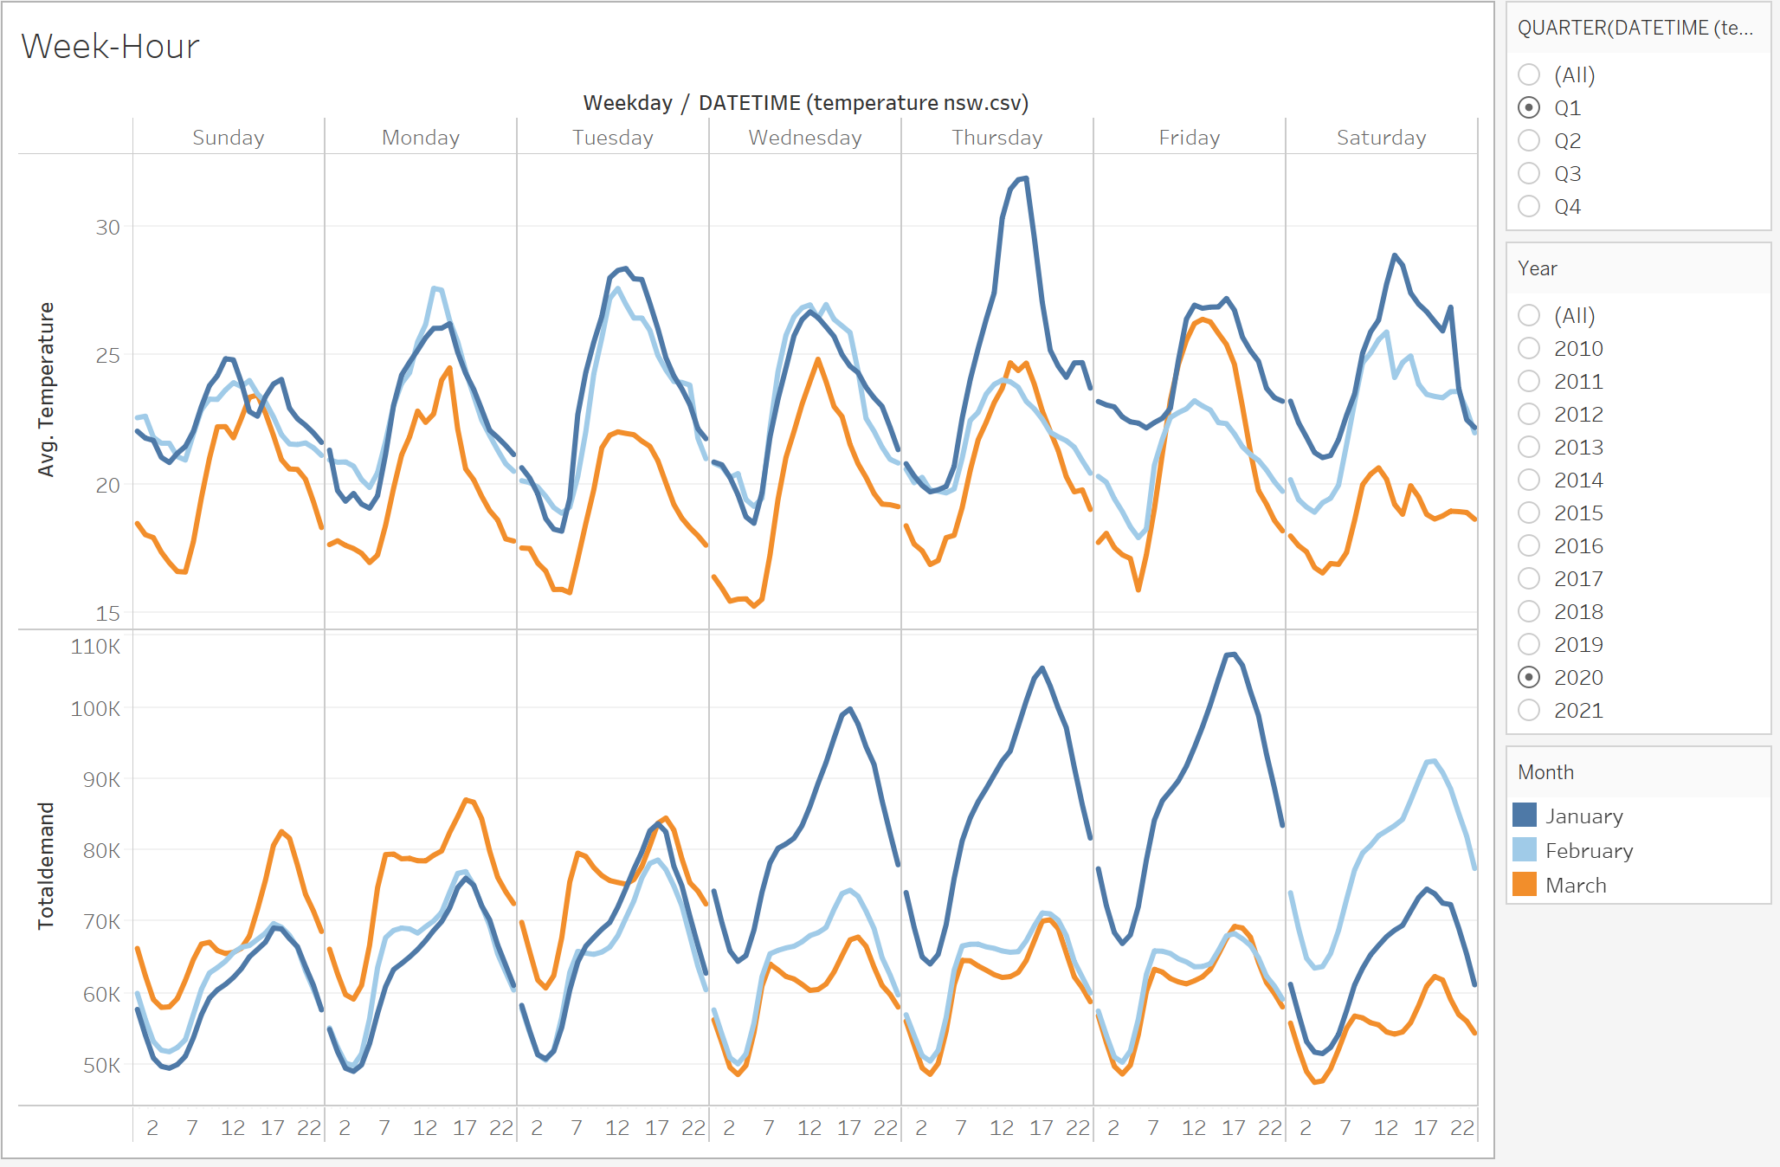
Hourly temperature-demand in diff. weekdays trend
Demand somewhat follows temperature during off peak (nighttime) time.
Demand variation during daytime varies in different days and not always proportional to temperature.

Slide 5
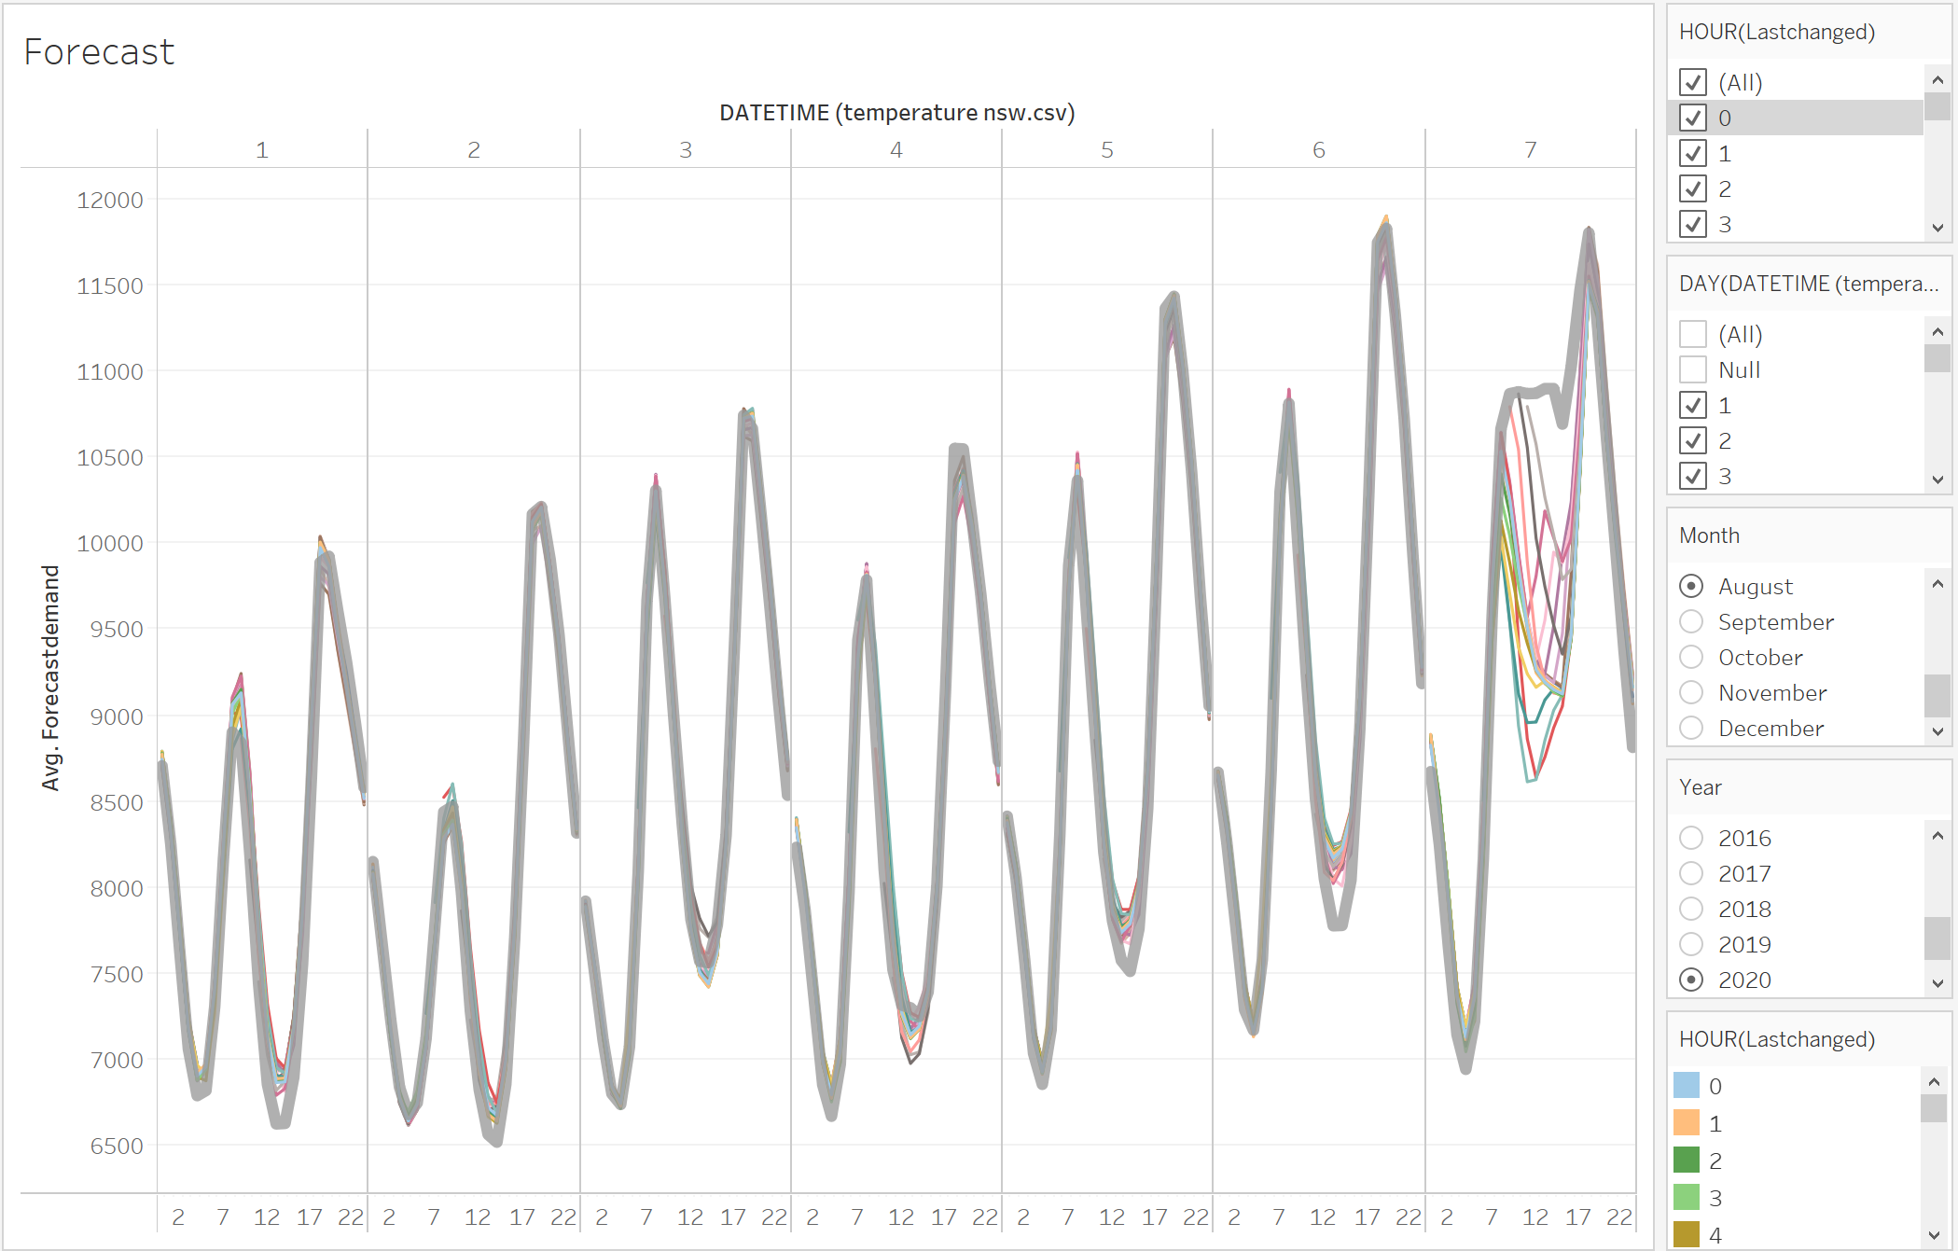
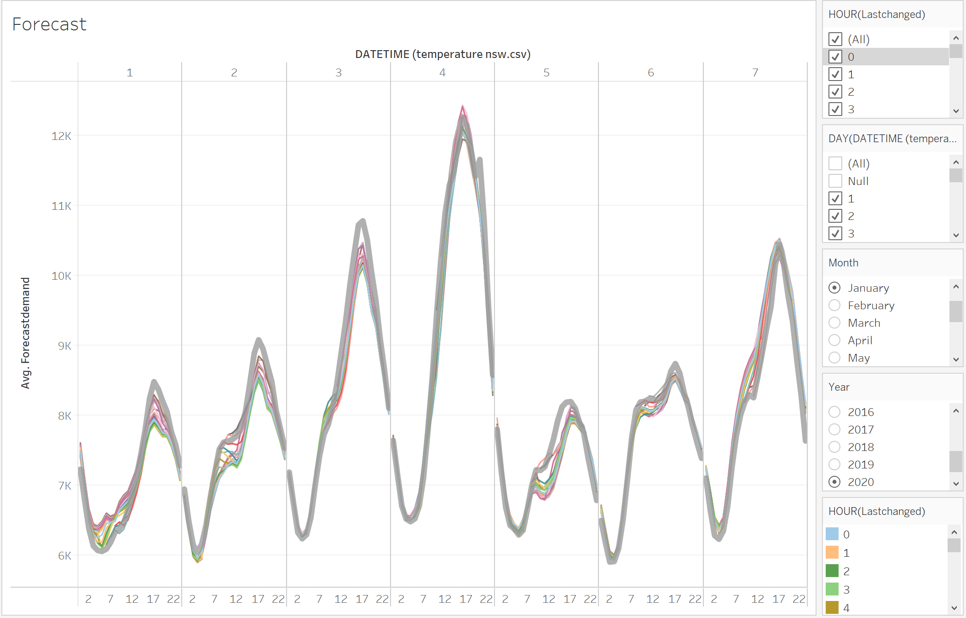
Hourly Forecast vs Demand (Jan and Aug 2020 first 7 days)
Current forecasts are pretty good in some hours and in some months.
Forecast suffers accuracy during day time.

